Slide 1

THANK YOU!
Thanks to teachers, parents and students for their participation and engagement.
Thanks to the distinguished speakers, panelists and workshop facilitators for the insightful and inspiring sessions.
Thanks to the Board of Engineers Malaysia (BEM) and the Institution of Engineers Malaysia ( IEM ) for the support and engagement of IEM Young Engineers Section (YES) Members.

Slide 2
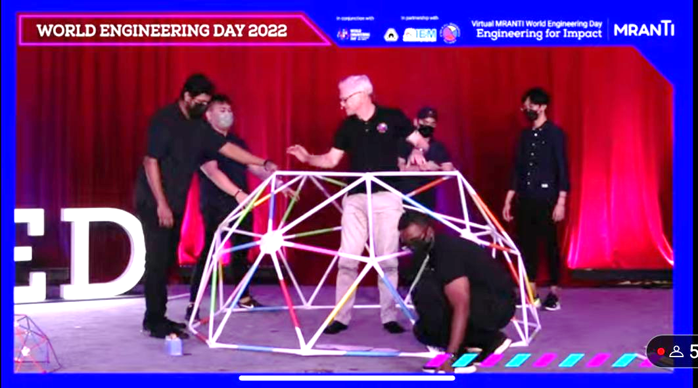
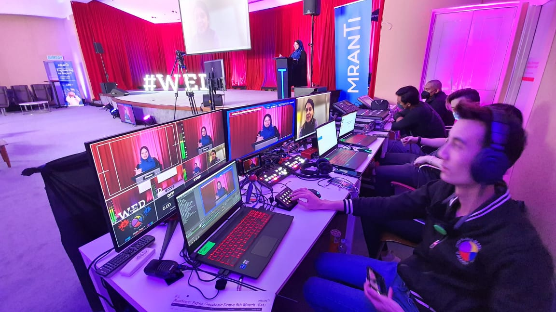
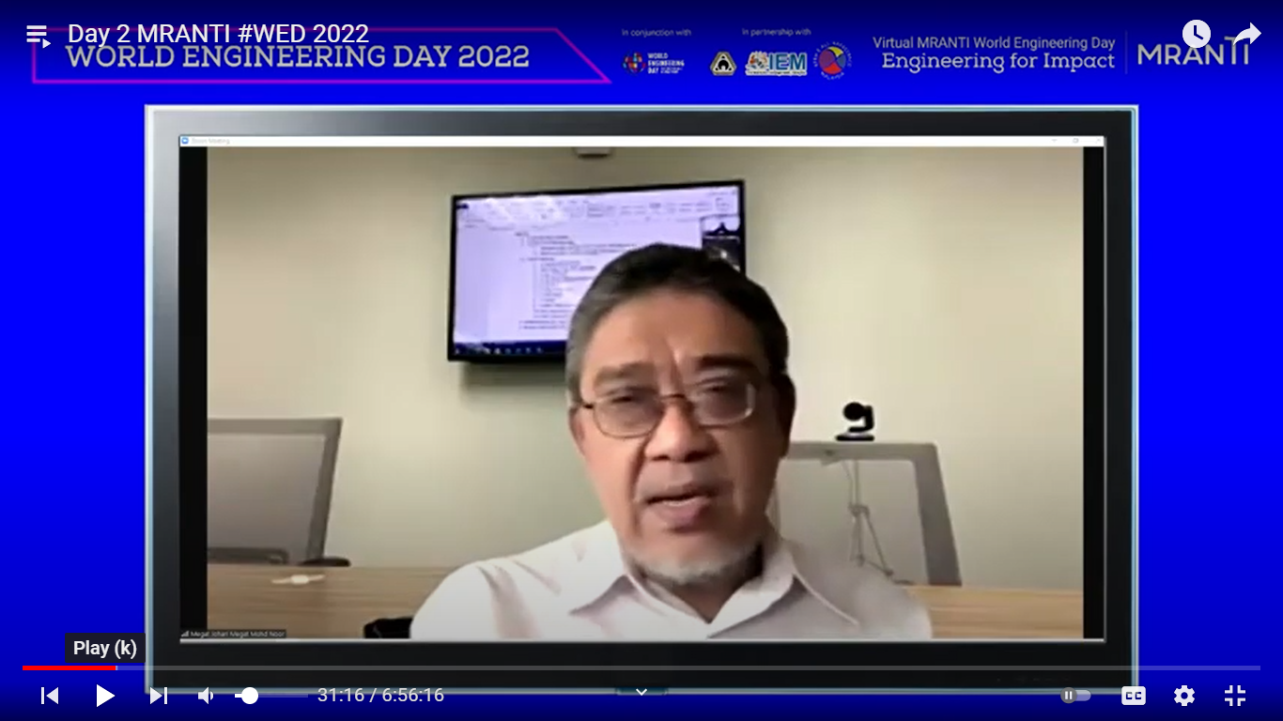
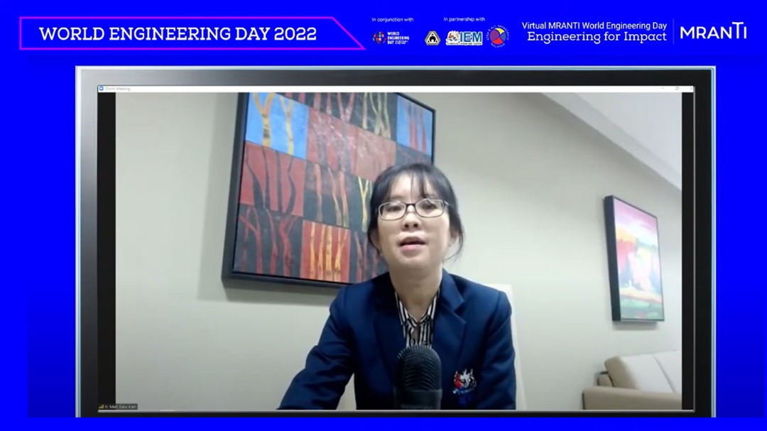
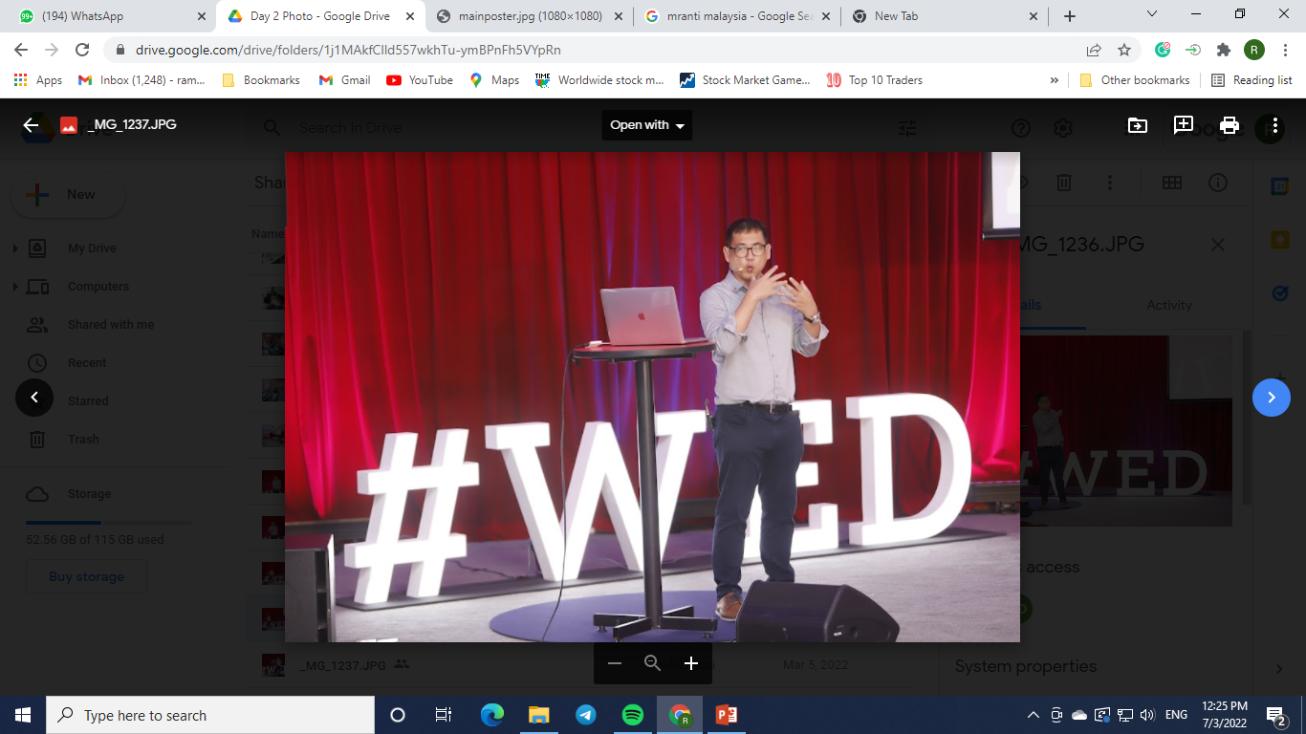
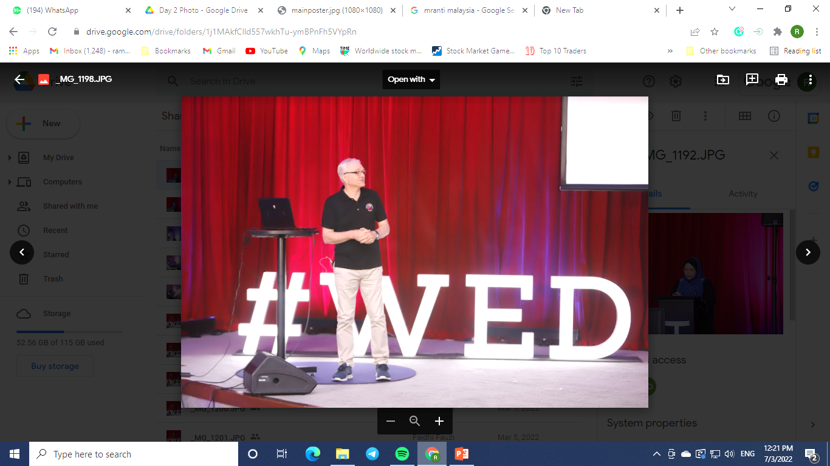
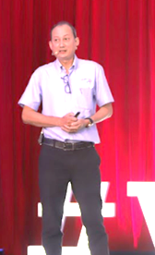
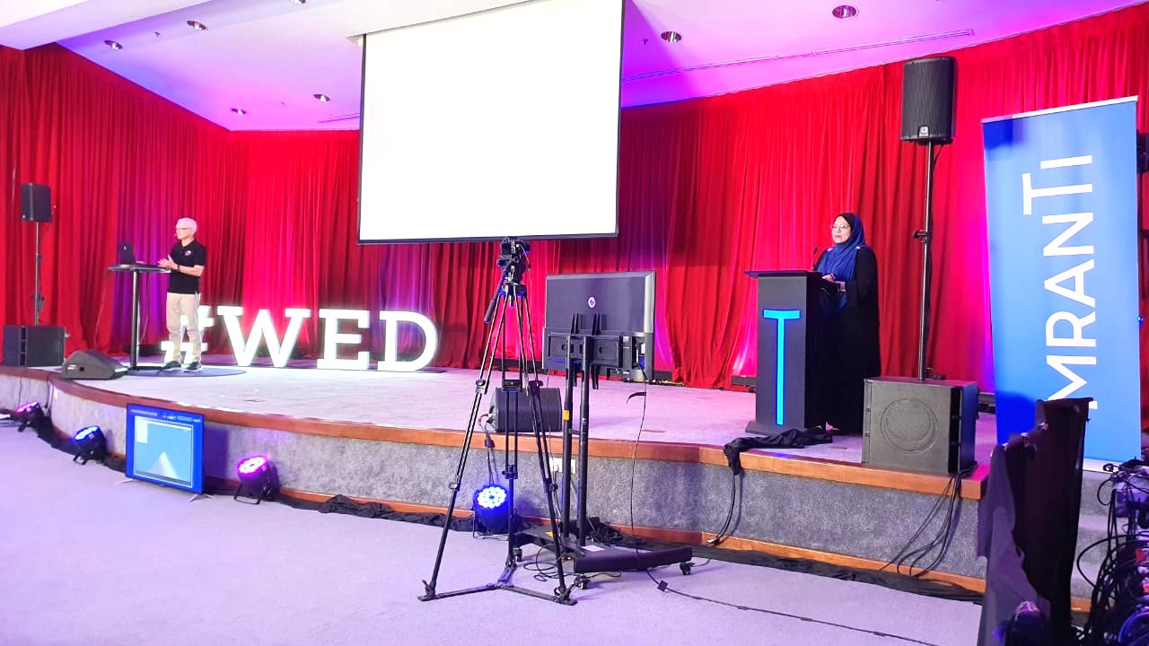
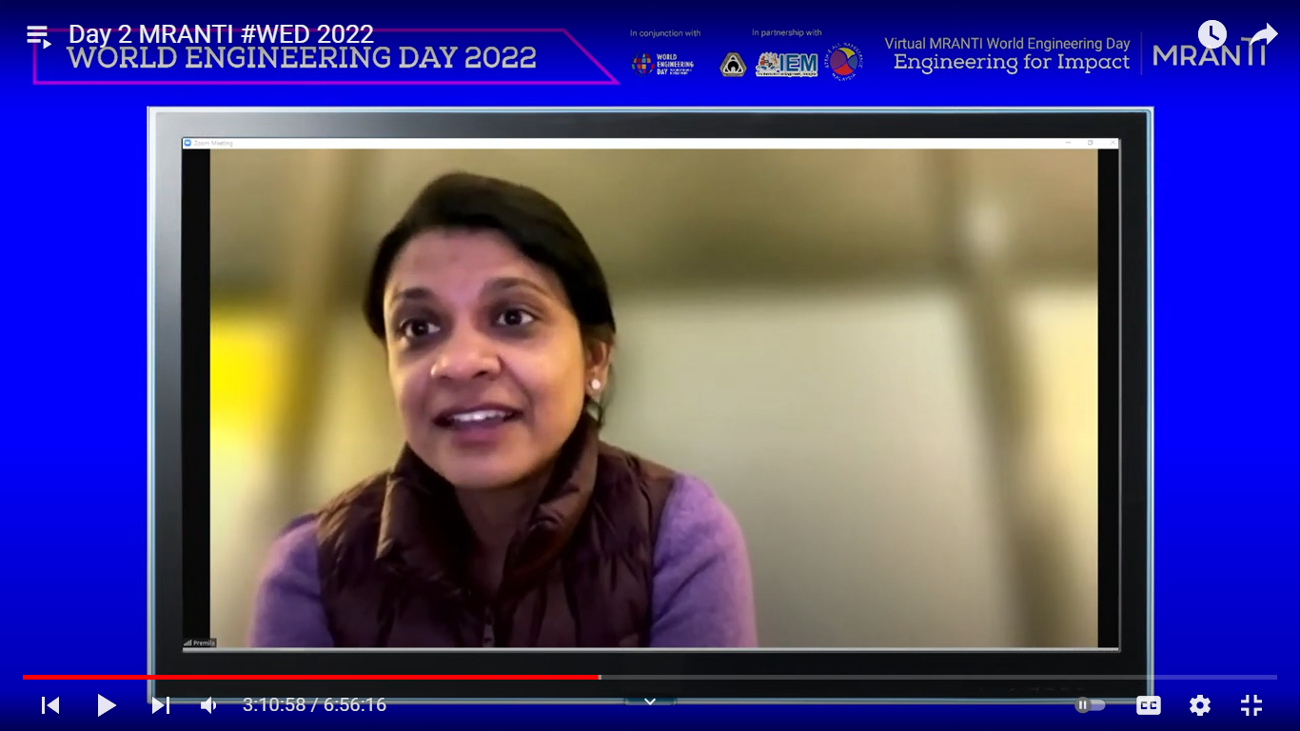
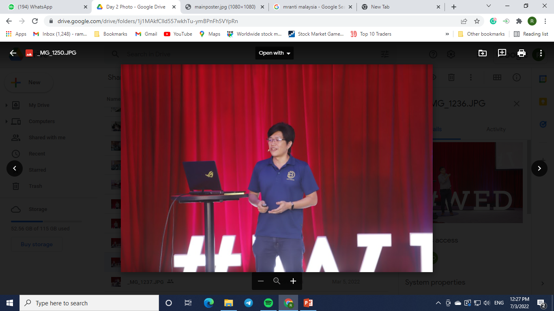
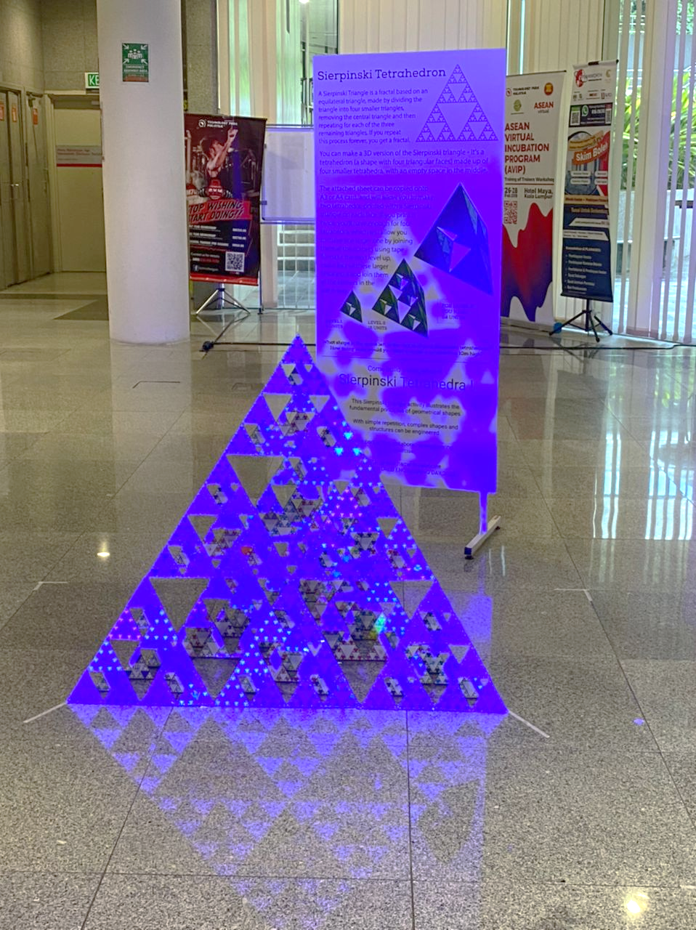
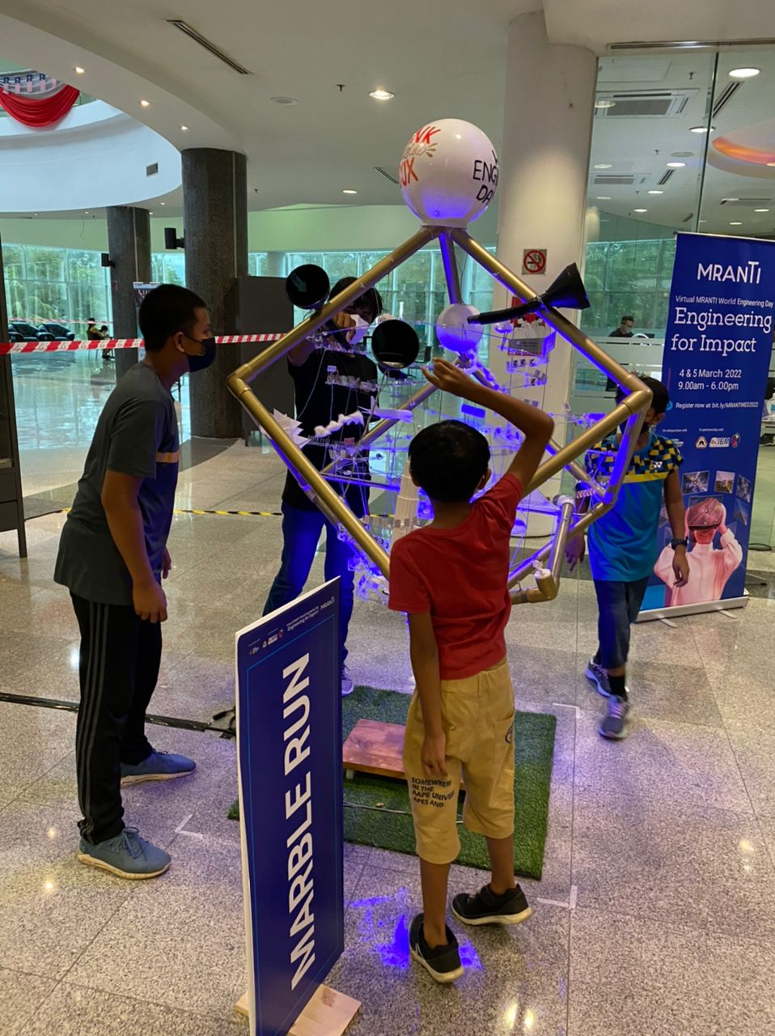
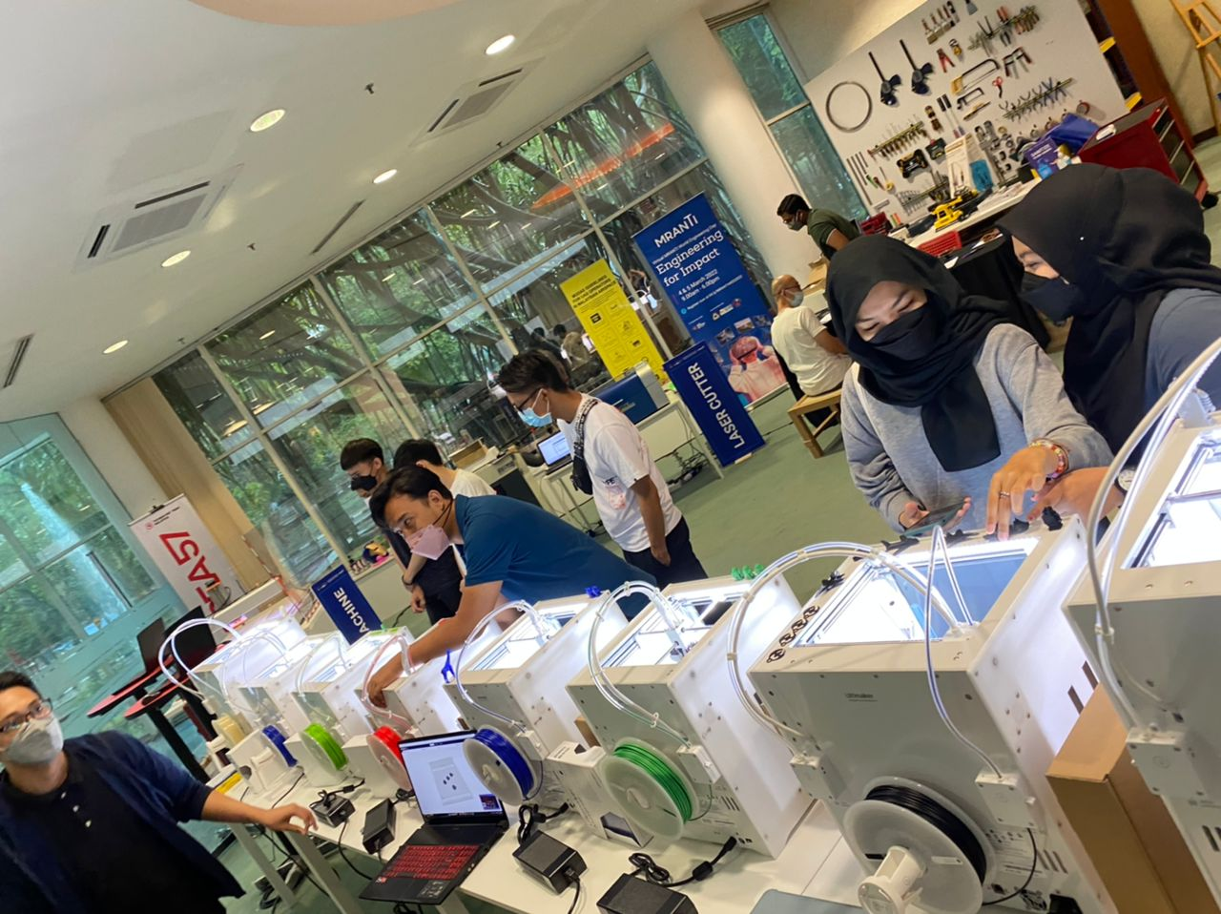
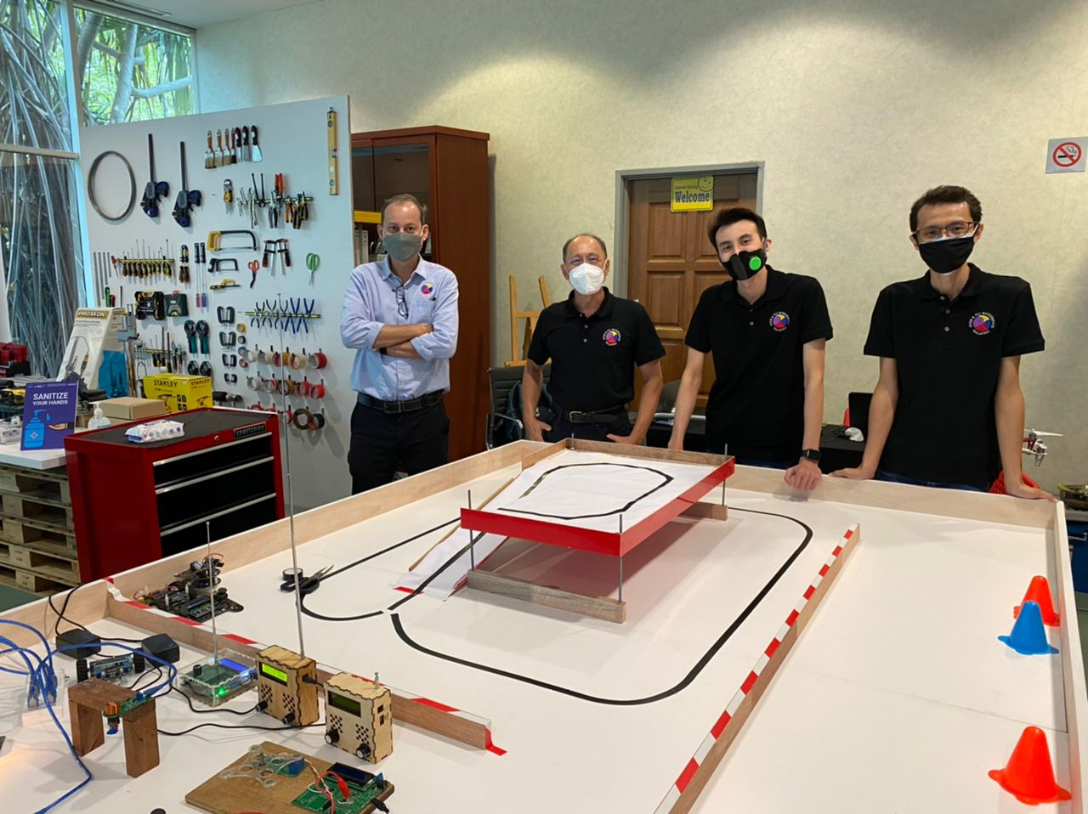
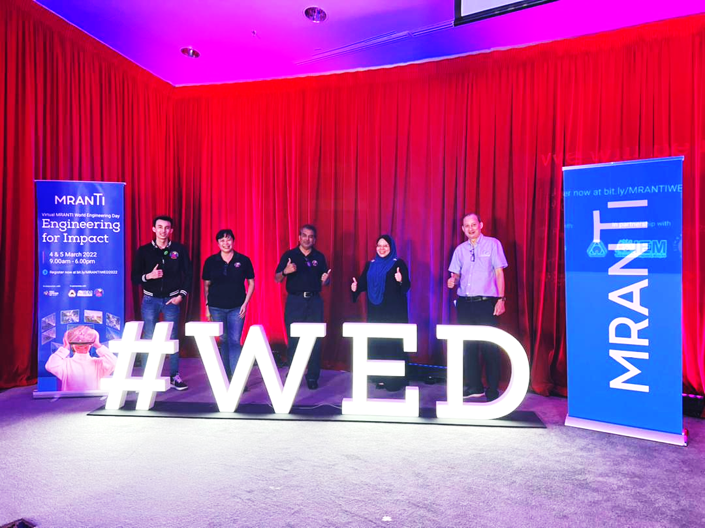
If you missed the Forums, Pocket Talks, Quizzes and the Engineering Challenges, please visit:
www.worldengineeringday.my
You may watch the Day 2 MRANTI #WED 2022 video and attempt the quizzes to win prizes.
Closing dates :
Quizzes based on Pocket Talks: Technology Sharing & Career Paths : 10 March 2022.
Engineering Challenge 1: Biomimicry Ideas for Sustainability : 19 March 2022.
Engineering Challenge 2: Paper Geodesic Dome : 19 March 2022.

